Slide 1
Implementing the Least Privilege Principle in Security
Minimizing Risk by Restricting Access
By: Curtis Crawford
Notes:
Good day, everyone. For those of you that don’t know me, which is most of you, my name is Curtis Crawford, and I’m here from Lighthouse Labs where I’m wrapping up my studies in cybersecurity with the goal of graduating *fingers crossed*, and launching my career in this field. Today, I’ll be talking about a critical concept in cybersecurity—the principle of least privilege. This principle, though straightforward, plays a key role in protecting systems by limiting access to what’s absolutely necessary.

Slide 2

Premium House Lights Incident
During the Premium House Lights Inc. incident: What happened?
Unauthorized access
Compromised customer payment and personal data.
Easiest way to mitigate this risk?
Implementing the Principle of Least Privilege
Notes:
During the Premium House Lights incident, unauthorized access allowed an attacker to compromise customer payment and personal data. By implementing the Least Privilege Principle, access would have been restricted only to essential personnel, which would have significantly reduced the attacker’s reach and limited the exposure of sensitive information. The Principle of Least Privilege minimizes potential damage in case of a breach by ensuring each user has only the access necessary for their role.

Slide 3

The Stuck Elevator Incident
Image - https://toonhole.com/2015/01/elevator/
Notes:
As everyone here comes from all different walks of life, how about an example we all can understand, let’s imagine this scenario: a company hires a new junior employee in the IT department. On their first day, they’re given unrestricted access to the entire network to help them 'get familiar' with the system. While exploring, they accidentally misconfigure settings on a shared drive. This small, innocent mistake causes disruptions in the system, including the building's control panel, which, unbeknownst to them, is also tied to the company’s elevator access. By the end of the day, employees were locked in an elevator for two hours! A single point of access oversight led to unnecessary inconvenience and cost – all because one person had too much access. This is just a quick example of why implementing the principle of least privilege is crucial.

Slide 4
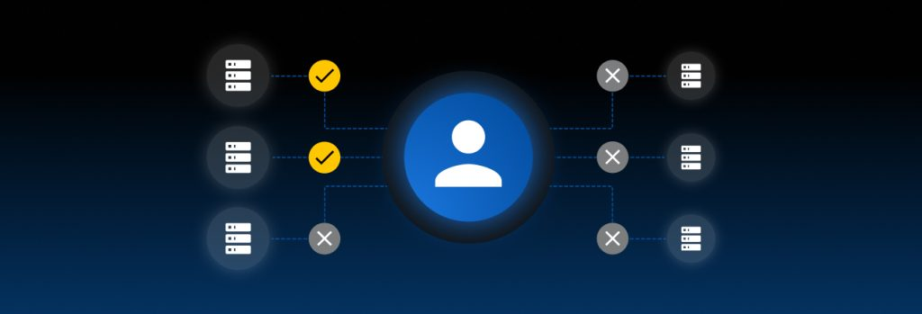
What is the Least Privilege Principle?
Image - https://www.keepersecurity.com
Definition: Granting only the minimum access necessary for users to perform their job functions.
Goal: Limit exposure to sensitive systems and data, reducing potential points of compromise.
Notes:
So what is the least privilege principle? Well, the privilege of least principle is granting only the minimum access necessary for users to perform their job functions. And the goal is to limit the exposure of users to sensitive systems and data which will reduce potential points of compromise. The least privilege principle is a core security concept that ensures employees have just enough access to perform their duties. This minimizes the risk of accidental or intentional data breaches, keeping systems and data secure.

Slide 5
Why is Least Privilege Important?
Prevents unauthorized access
Reduces potential damage from insider threats
Limits the scope of attack vectors
Notes:
I’m sure after our quick story at the beginning of this presentation, you might have an idea as to why the principle of least privilege is important, but let’s look at some of the key concepts.
Some of the benefits of the principle of least privilege is that it: Prevents unauthorized access.
It reduces potential damage from insider threats.
& it limits the scope of attack vectors.
By implementing least privilege, we reduce the 'blast radius' in case of a mistake or attack. The more privileges someone has, the greater the potential impact if their credentials are compromised or if they make an error.

Slide 6
How to Implement Least Privilege
Access Controls: Use role-based access control (RBAC) to assign permissions based on job roles.
Regular Audits: Review access regularly to ensure compliance.
Granular Permissions: Break down permissions to ensure users only access what’s necessary.
Notes:
Implementing least privilege requires structured access control, regular audits, and creating granular permissions. With access controls we can use a role-based methodology to assign permissions based on job roles.
Regular audits allow us to review access to continuously ensure compliance.
& granular permissions are how we break down permissions to ensure users only access what’s necessary. These methods can help to prevent what’s known as ‘privilege creep,’ where employees gradually accumulate more access than necessary over time.

Slide 7
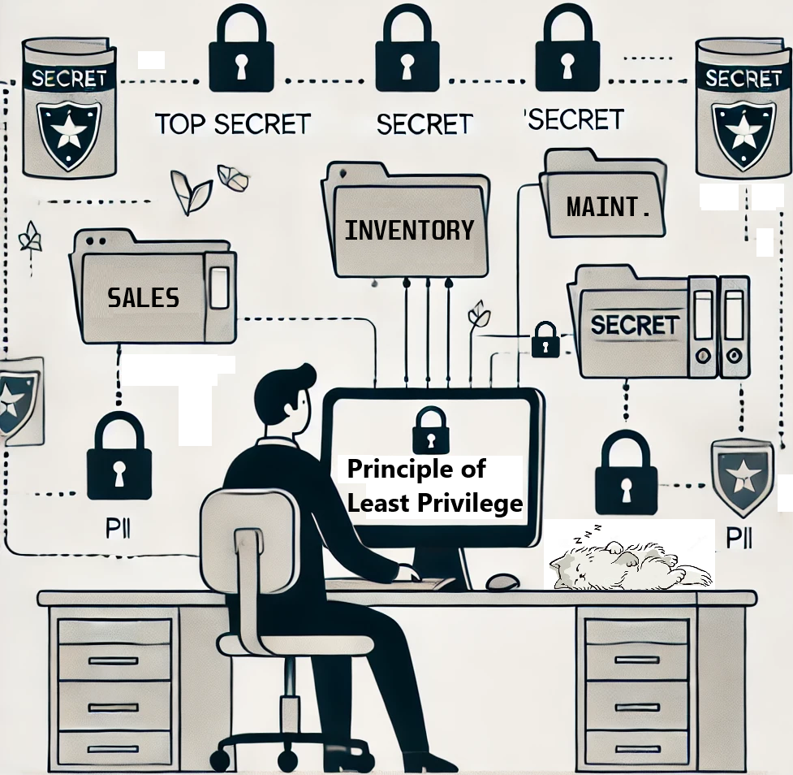
Summary
Questions?
Image - https://chatgpt.com
Notes:
As we’ve seen in these few slides, the principle of least privilege isn’t just a guideline; it’s a fundamental part of reducing risk and maintaining security. By ensuring that access is limited to only what’s essential, we not only protect sensitive information but also strengthen our overall security posture. Implementing least privilege is a proactive way to minimize potential damage and keep our systems resilient. I want to thank you for your attention, and let’s remember that sometimes, the simplest restrictions can make the biggest difference. AAANNNDD, for those of you wondering who counted along with the slides, least privilege was said 14 times (including that one).
Thank you.

Slide 8
References
Saltzer, J. H., & Schroeder, M. D. (1975).
The Protection of Information in Computer Systems. Proceedings of the IEEE, 63(9), 1278-1308.
https://doi.org/10.1109/PROC.1975.9939
National Institute of Standards and Technology. (2020).
Security and Privacy Controls for Information Systems and Organizations (NIST SP 800-53 Rev. 5).
Retrieved from https://nvlpubs.nist.gov/nistpubs/SpecialPublications/NIST.SP.800-53r5.pdf
SANS Institute. (2021). Implementing the Principle of Least Privilege:
Practical Considerations for Cybersecurity.
Retrieved from https://www.sans.org/white-papers/39804/
Whitman, M. E., & Mattord, H. J. (2021).
Principles of Information Security (7th ed.).
Cengage Learning.

